Slide 1
ENTIRE HOME SURVEILLANCE APPROACH USING PI AND INTELLIGENT CAMERAS WITH MOBILE APP NOTIFICATION
Presented by ,
Santhosh M (312417106074)
Sri Dharshan V S (312417106094)
Guided by ,
Mr. J. Bino M.E.,
Assistant Professor

Slide 2
OBJECTIVE
The main aim of this project is to ensure safety and security to home through intelligent camera surveillance with mobile app notification.
In this project we will secure our home with multiple Raspberry Pi, camera and a mobile application which alerts by predicting the intruder.
A mobile application enables live streaming and alerts the user through notifications.
Our solution is flexible and interoperable with other devices.

Slide 3
LITERATURE SURVEY
TITLE OF THE PAPER WITH AUTHOR NAME | YEAR OF PUBLICATION | JOURNAL NAME | METHODOLOGY | ADVANTAGE | DISADVANTAGE
“3-D Deconvolutional Networks for the Unsupervised Representation Learning of Human Motions” Chun-Yang Zhang , Yong-Yi Xiao, Jin-Cheng Lin, C. L. Philip Chen , Fellow, IEEE, Wenxi Liu , and Yu-Hong Tong | 2020 | IEEE Transactions on Cybernetics | 3-D deconvolutional network (3DDN) | The experimental results from three datasets: KTH data;HMDB-51; and UCF-101, demonstrate that the proposed 3DDN is an alternative approach to feedforward convolutional neural networks (CNNs) | The hyperparameters of the 3DDN models are determined by trial and error, including the number of hidden layers and feature maps will lead to improper results
“PrivHome: Privacy-Preserving Authenticated Communication in Smart Home Environment” [2019, VOL. 99, NO. 99] Geong Sen Poh, Prosanta Gope, Member, IEEE , and Jianting Ning | 2019 | IEEE Transactions on Dependable and Secure Computing | lightweight entity and key-exchange protocol, and an efﬁcient searchable encryption protocol | A smart home enables users to access devices such as lighting, HVAC, temperature sensors, and surveillance camera. It provides a more convenient and safe living environment for users | Less accuracy.

Slide 4
LITERATURE SURVEY
TITLE OF THE PAPER WITH AUTHOR NAME | YEAR OF PUBLICATION | JOURNAL NAME | METHODOLOGY | ADVANTAGE | DISADVANTAGE
“Continuous Human Motion Recognition With a Dynamic Range-Doppler Trajectory Method Based on FMCW Radar “ [2019, VOL. 57, NO. 9, ] Chuanwei Ding , Student Member, IEEE, Hong Hong , Member, IEEE, Yu Zou,Student Member, IEEE, Hui Chu ,Francesco Fioranelli , Member, IEEE and Julien Le Kernec , Senior Member, IEEE | 2019 | IEEE Transactions on Geoscience and Remote Sensing | range-Doppler trajectory (DRDT) method based on the frequency-modulated continuous-wave (FMCW) | the DRDT is extracted from these frames to monitor human motions in time, range, and Doppler domains in real time. | Less accuracy.
“PRNU-Based Camera Attribution from Multiple Seam-Carved Images ” [2017, VOL. 20, NO. 5, ] BSamet Taspinar, Manoranjan Mohanty, and Nasir Memon | 2017 | IEEE Transactions on Information Forensics and Security | PRNU Noise Pattern, Countering SeamCarving-Based Anonymization, Source Camera Attribution. | seamcarved images from the same camera, source attribution can still be possible even if the size of uncarved blocks in the image is less than the recommended size of 50×50 pixels. | Less real time process.

Slide 5
LITERATURE SURVEY
TITLE OF THE PAPER WITH AUTHOR NAME | YEAR OF PUBLICATION | JOURNAL NAME | METHODOLOGY | ADVANTAGE | DISADVANTAGE
“An Integrated Cloud-Based Smart Home Management System with Community Hierarchy ”, [2016, Vol No: 2162-237X] Ying-Tsung Lee, Wei-Hsuan Hsiao, Chin-Meng Huang and Seng-Cho T. Chou | 2016 | IEEE Transactions on Consumer Electronics | Smart Home Management System, Community Broker, Cloud Services, MQTT | At the home end, a home intranet was created by integrating a fixed touch panel with a home controller system and various sensors and devices to deliver, for example, energy, scenario information, and security functions. | Costly kit
“Presentation Attack Detection for Face Recognition using Light Field Camera”- R. Raghavendra Kiran B. Raja Christoph Busch Norwegian Biometric Laboratory, Gjøvik University College, Norway | 2015 | IEEE Transactions on Image Processing | Face Presentation Attack Detection (PAD) | The light field face artefact database have revealed the outstanding performance of the proposed PAD scheme when benchmarked with various well established state-of-the-art schemes. | There exists no superior PAD technique due to evolution of sophisticated presentation attacks

Slide 6
EXISTING SYSTEM
In the existing system, a 3-D deconvolutional network (3DDN) for representation learning of high-dimensional video data, in which the high-level features are obtained through the optimization approach.
The 3DDN decomposes the video frames into spatiotemporal features under a sparse constraint in an unsupervised way.

Slide 7
DISADVANTAGES
But the disadvantage is that the 3DDN models currently provide low- and middle-level features of video clips, when they only have fewer hidden layers.
The hyperparameters of the 3DDN models are determined by trial and error, including the number of hidden layers and feature maps will lead to improper results.

Slide 8
PROPOSED SYSTEM
Our system has the goals of monitoring our driveway outside the house for motion and people/vehicles
Detect intruders and help with face detection/recognition using advanced SSD (Single Shot Multi-Box Detector), Ultra-light detector and ZMQ algorithm
Performing face recognition and alerting the home owners if someone is inside (i.e. not you or your family members).
A mobile app will be developed by which the user can be notified automatically.
The mobile app also enables live streaming & gives three options to the user to call the police, lock the door and also ignore the alert.
Alarm can also be initiated when intruder gets detected

Slide 9
ADVANTAGES
Cheap and effective solution for home surveillance
Provides alert to the home owner in case of intruder detection
A proof for police department for finding the thief
Automatic SMS option for emergency situation
Mobile application is developed
App notification to the user
Live streaming through the mobile application

Slide 10
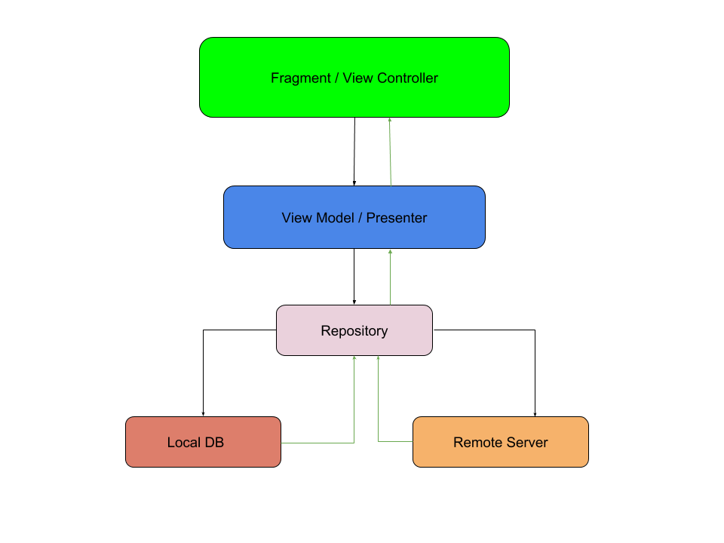
BLOCK DIAGRAM

Slide 11












FLOWCHART
PROCESSOR INITIALIZATION
COMUNICATION
ESTABLISHMENT
INITIATES ALARM
AUTOMATICALLY LOCKS THE DOOR
CAMERA INITIALIZATION
PERFORM OBJECT DETECTION
USER RESPONDS
INFORMS THE POLICE
DETECT THE PRESENCE OF
PERSON
HUB MODULE SEND NOTIFICATION TO THE USER
APPLY FACE DETECTION AND RECOGNIZE THE FACE
PASS INFORMATION TO THE HUB MODULE
COMPARE WITH THE REGISTERED FACES
IF UNKNOWN FACE DETECTED
CHECK FOR UNKNOWN FACE

Slide 12
TECHNICAL SPECIFICATIONS
H/W SPECIFICATIONS:
PC
RAM : 8 GB
Processor : i5
Hard disk : 1 TB
Camera
Raspberry Pi

Slide 13
TECHNICAL SPECIFICATIONS
S/W SPECIFICATIONS:
VISUAL STUDIO
PYTHON

Slide 14
APPLICATIONS
This project helps in saving people property and money as well as automates the records which helps to punish the thief.
Implementation of this project also gives rise to many applications such as provide in bank lockers, etc.
Mainly its used in home for home security purpose.

Slide 15
CONCLUSION
Criminals may find an unprotected entry point into the home if just a front and backdoor sensor or a camera is used.
By taking a tour around the perimeter of the home to spot any security weaknesses and with the help of cameras, raspberry pi, buzzer, mobile application, surveillance is done.
So, in this way of home surveillance by intruder detection, recognition and alerting protection can be ensured.

Slide 16
FUTURE ENHANCEMENT
This can not only be implemented in the home areas alone but also in the office areas, areas where high security requirements are needed like security vault, bank lockers, lockers which are transmitted from place to place and many more to ensure properties with more safety.

Slide 17
REFERENCES
[1] Chun-Yang Zhang , Yong-Yi Xiao, Jin-Cheng Lin, C. L. Philip Chen , Fellow, IEEE,
Wenxi Liu , and Yu-Hong Tong, “3-D Deconvolutional Networks for the Unsupervised Representation Learning of Human Motions”, IEEE Transactions on Cybernetics, Pages 1-13, [March 2020]
[2] Geong Sen Poh, Prosanta Gope, Member, IEEE , and Jianting Ning, “PrivHome: Privacy-Preserving Authenticated Communication in Smart Home Environment”, IEEE Transactions on Dependable and Secure Computing, Pages 1-1, [May 2019, VOL. 99, NO. 99]
[3] Chuanwei Ding , Student Member, IEEE, Hong Hong , Member, IEEE, Yu Zou, Student Member, IEEE, Hui Chu, Francesco Fioranelli , Member, IEEE, Julien Le Kernec , Senior Member, IEEE, “Continuous Human Motion Recognition With a Dynamic Range-Doppler Trajectory Method Based on FMCW Radar”, IEEE Transactions on Geoscience and Remote Sensing, Pages 6821-6831 [September 2019, VOL. 57, NO. 9, ]

Slide 18
REFERENCES
[4] BSamet Taspinar, Manoranjan Mohanty, and Nasir Memon, “PRNU-Based Camera Attribution from Multiple Seam-Carved Images”, IEEE Transactions on Information Forensics and Security, Pages 3065-3080 [August 2017, VOL. 20, NO. 5 ]
[5] Ying-Tsung Lee, Wei-Hsuan Hsiao, Chin-Meng Huang and Seng-Cho T. Chou, “An Integrated Cloud-Based Smart Home Management System with Community Hierarchy”, IEEE Transactions on Consumer Electronics, Pages 1-9, [February 2016, Vol No: 2162-237X]
[6] R. Raghavendra Kiran B. Raja Christoph Busch Norwegian Biometric Laboratory, Gjøvik University College, Norway, “Presentation Attack Detection for Face Recognition using Light Field Camera”, IEEE Transactions on Image Processing, Pages 1060-1075, [March 2015]

